Slide 1
Models of Health
Biomedical Model of Health
Social Model of Health
Ottawa Charter for health promotion

Slide 2
Biomedical model of health
Is the ‘quick fix’ or ‘bandaid’ approach to health
Centres around health professionals eg doctors, hospitals, medication
Refers to diagnosis, treatment and cure.
Has been around for thousands of years

Slide 3
What are some advantages and disadvantages of this model?

Slide 4
Biomedical Model of Health
Advantages:
Disadvantages:
Advancement in technology
Effective treatment
Extend life expectancy
Improve quality of life
Relies on professional health workers and technology
Narrow view of health (individual focus rather than holistic view)
Not every condition can be treated
Expensive
Watch 'Town of Allopath' video on learning page

Slide 5
Social Model of Health
Definition:
The Social Model of Health takes into account the SOCIAL, CULTURAL, ENVIRONMENTAL and ECONOMIC determinants which AFFECT health and produce INEQUITIES within the population rather than the disease or injury itself.
Key Point:
If these determinants can be addressed, many diseases eg CVD, diabetes mellitus Type 2, obesity can be prevented.

Slide 6
Social Model of Health
Addresses the broader influences on health eg social, cultural, environmental & economic factors, rather than the disease or injury itself
It does this by taking into account the social determinants of health E.g. access to health care, SES, social connectedness as if you have those, you will have a higher health status and many diseases can be prevented or managed.
Works together with the Biomedical Model of health

Slide 7
Principles of the Social Model of Health
Addresses the broader determinants of health
Acts to reduce social inequities
Empowers individuals & communities
Acts to enable access to health care
Involves intersectoral collaboration

Slide 8
Addresses the broader determinants of health:
Acknowledges the influence of GENDER, CULTURE, RACE, ETHNICITY, SES, GEOGRAPHICAL, LOCATION and the influence they can have on health status & health
Acts to reduce social inequities:
If community/government can improve SES, or social exclusion or issues with race or gender, health status will improve
Empowers individuals & communities:
People will change their behaviour if they feel they have control and know how to do it
Notes:
Behavioural is an easy determinant to choose if using this one. Smoking may be done because everybody at work smokes, or you are unemployed so bored, it’s manly to smoke, so need to take those factors into consideration to get that person to give up smoking and improve his health- pt 1. QUIT line gives strategies on how to give up smoking and step by step advice – pt 3

Slide 9
Acts to enable access to health care:
If people have affordable, cultural and geographical access to health care, their health status will improve
Involves intersectoral collaboration:
Many different organisations and community groups can work together to improve health status
Notes:
Different cultures need to feel comfortable going to see doctor eg have an interpreter or a female doctor; shouldn’t have to travel for days to see doctor – pt 1
Schools can educate kids about dangers of smoking; they educate their parents as do the anti smoking ads by the govt; doctors surgeries have pamphlets. on how to give up smoking and doctors talk to patients about risks of smoking; dentists talk about yellow teeth and more tooth decay; state governments have laws to prohibit smoking in schools, cafes, so all working together to reduce smoking and improve health; not just the health profession who should be in charge of improving health – pt 2

Slide 10
Social model v’s Biomedical model explained
Biomedical and social models video on learning page

Slide 11
Social Model of health
Advantages?
Disadvantages?
Promoted good health and assists in preventing diseases
Promotes overall wellbeing
Relatively inexpensive
Focuses on population groups that are in need
Education is passed on
Health isn’t the responsibility of just the individual but also health sectors
Not every condition can be prevented
Does not promote the development of technology and medical knowledge
Does not address the health concerns of an individual
Health promotion messages can be ignored.

Slide 12
Comparison of the two models
Social Model
of Health
Biomedical Model
of Health

Slide 13
Social Model v’s Biomedical model of health
Explain why it is important to have both the biomedical and social models of health if we are to improve health status.
(2 marks)

Slide 14
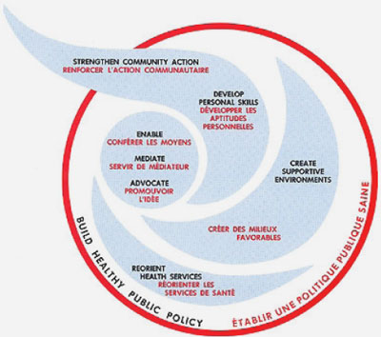
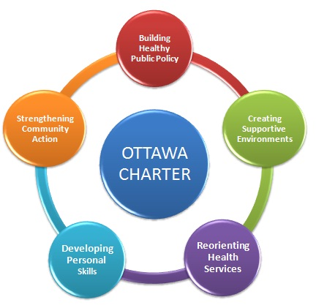
Ottawa Charter for Health Promotion
(often referred to as the Ottawa Charter)

Slide 15
Health promotion refers to “enabling people to increase control over, and to improve their health.”
Ottawa Charter : provides a framework on which to develop health promotion policies.
Notes:
Defn- so focuses on prevention, rather than cure and looks at the causes of the disease eg smoking, and gives strategies to give up smoking
Prerequisites – health won’t improve if you are starving, or really scared, or homeless, or have no money or education so govts have to work on having those prerequisites before health promotion will work – one reason why they make kids stay at school til at least 16 – more likely to get job which eradicates most of the other issues
Last dot point – sustainable means for the future, so no good chopping down all of the trees to build houses if you don’t plant some more trees. See page 232 for examples of each dot point

Slide 16
Ottawa Charter Prerequisites
Based on certain prerequisites that must be in place for improvement in health to occur
Peace
Shelter
Education
Food
Income
Social justice & equity
Stable ecosystem
Sustainable resources eg food, water, timber for building

Slide 17
Strategies for health promotion
Advocate:
actions which work to gain support from governments to improve all of the determinants of health, so lobbying governments for that bike path or new drink driving laws
Enable:
Helping people (enabling) to achieve equity in health by improving access to education, jobs, shelter.
Should occur by empowering people to take control of own health, not by handouts
Mediate:
Changes which promote health could lead to conflict between different groups eg banning smoking outside cafes. Health professionals and officials need to mediate with all stakeholders to show the positive health effects and to listen to concerns.
Notes:
Advocate: Good health is really important for quality of life so all of the determinants of health should be positive. For that to happen, people have to work on governments to ensure that health laws or policies happen. Could also be through social media, public speaking like TED talks, anything to get a groundswell of opinion to change governments mind – that way health promotion campaigns can then be developed
Enable – all population groups should be targeted eg indigenous, rural and remote groups. Low cost education courses could be encouraged; skills developed to increase job opportunities
These three strategies need to be learned and they aren’t easy to remember.

Slide 18
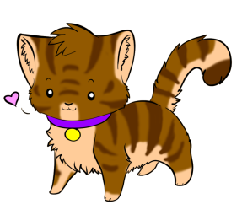
Action areas: Ottawa Charter
Build Healthy Public Policy
Create Supportive Environments
Strengthen Community Action
Develop Personal Skills
Reorient health services
Bad Cats Smell Dead Rats
Notes:
These action areas reflect the principles of the SMOH and you need to be all over both of the SMOH and the Ottawa Charter.

Slide 19
Build Healthy Public Policy:
Any law or policy by governments & organisations which will improve health
Eg. seat belt law, or no bullying in schools, or no smoking in public areas; removing taxes on healthy foods.
Create Supportive Environments:
Helps people to practise healthy behaviours
Eg. Shade areas at school to encourage sunsmart behaviours; Quitline for smokers to call if they feel the urge to smoke
Strengthen Community Action:
Focuses on building links between the individual & the community
Focuses on the community working together to achieve an improvement in health
Eg. local council works with older community to run free walking groups; road safety initiatives are a joint effort between government, Vicroads and TAC.
Notes:
B - One of the easiest action areas to remember.
C – another easy one to apply and think of examples
S – I find this one really tough and find it difficult to think of specific examples

Slide 20
Develop Personal Skills:
Education and enhancing life skills are the key aspect of this priority area.
Eg. Attending Cooking classes; learning strategies to deal with anxiety; Slip, Slop, Slap, Seek, Slide campaign
Reorient Health Services:
Getting the health profession and others to promote health, rather than diagnosing, and treating diseases
Eg. Doctors recommending physical activity to lose weight, rather than stomach stapling; dieticians coming to schools to promote healthy eating
Notes:
D – any life skill or knowledge which is acquired to improve health will be developing Personal skills – an easy one to apply to situations
R – can be tricky thinking of examples.
Overall, you need to know them all, but pick three that you are really comfortable with – and have examples

Slide 21
Health Promotion and Ottawa Charter explained
An introduction to Health Promotion and the Ottawa charter.mp4

Slide 22
Applying the models of health
Example… Reducing the rates of CVD
Biomedical model of Health:
Surgery to assist with treating the condition
Social Model/ Ottawa Charter:
Focus on healthy eating and physical activity to prevent the development of CVD.
Lets apply this to another…..

Slide 23
Example 1 - Using the 5 priority areas of the Ottawa Charter, try and address the issue of childhood obesity at a secondary school level.
Childhood obesity
Building public policy
Create supportive environments
Strengthen community action
Develop personal skills
Reorient health services

Slide 25
Example 2 - Using the 5 priority areas of the Ottawa Charter, try and address the issue of road accidents in P plate drivers at a secondary school level.

