Slide 1
Coins
By Zoe

Slide 2
1.
How many 10c coins make 20c?
+
=

Slide 3
Answer:

Slide 4
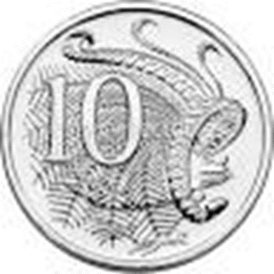
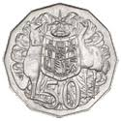
2.
How many 10c coins make 50c?
+
+
+
+
=

Slide 5
Answer:

Slide 6
3.
How many 10c coins make $1?
+
+
+
+
+
+
+
+
=

Slide 7
Answer:

Slide 8
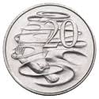
4.
How many 20c coins make $1?
+
+
+
+
=

Slide 9
Answer:

Slide 10
5.
How many 50c coins make $1?
+
=

Slide 11
Answer:

Slide 12
6.
How many ways can you make 50c?
+
+
=
+
+
+
=
+
=

Slide 13
Answer:

Slide 14
7.
I have three coins that total 40c- What coins are they?
+
+
=

Slide 15
Answer:

Slide 16
8
I have coins that make a dollar – What are they?
+
+
+
+
=

Slide 17
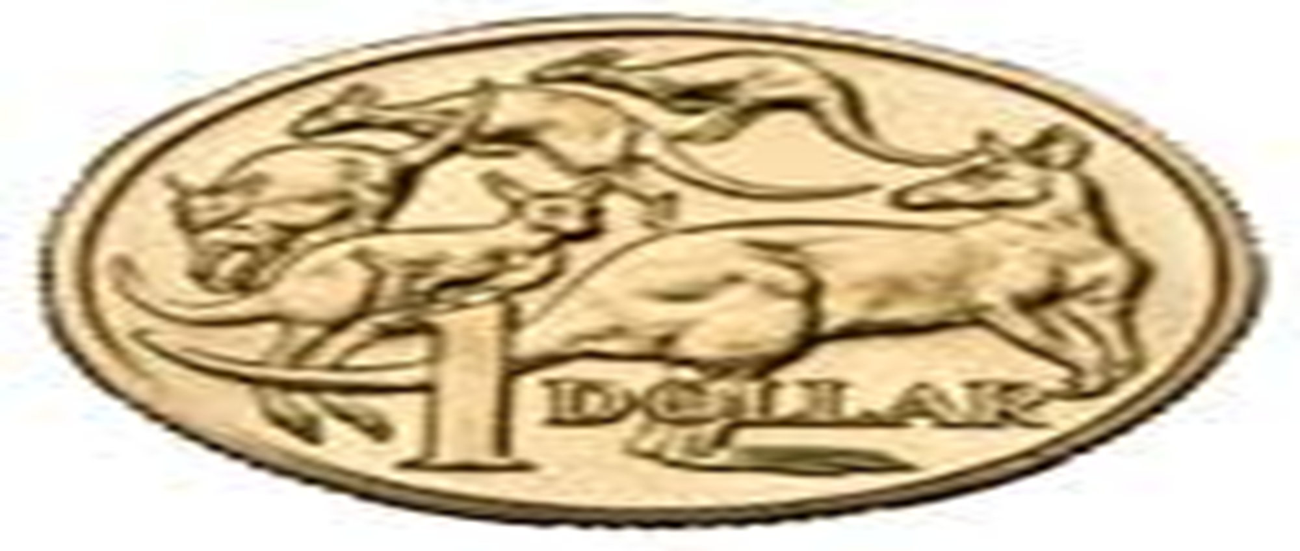
Answer:

Slide 18
What 1 coin could you use to buy a postcard that costs 40c?

Slide 19
Answer:

Slide 20
What 1 coin could you use to buy a pencil that costs 70c?

Slide 21
Answer:

Slide 22
What 1 coin could you use to buy a ice-cream that costs $1.50?

Slide 23
Answer:

Slide 24
Facts
By Zoe

Slide 25
At the Royal Australian Mint there is a staircase filled with five cent coins.

Slide 26
Did you know that our gold coins are not really made of gold and our silver coins are not made from silver? The gold coins are made from copper, aluminium and nickel and the silver coins are made from copper and nickel. This is because these metals cost less than gold or silver.

Slide 27
You cannot tell the value of a coin by looking at its size. The two dollar coin is smaller than the one dollar coin, the fifty cent coin and the ten cent coin, but is worth more than each of them and all of them added together!

Slide 28
Which coin do you think weighs the most? It is the fifty cent coin. Until 1969 the fifty cent coin was round! Now it has twelve sides.

Slide 29
Australian coins that have a bumpy edge are called ‘milled’ coins. Can you work out which ones are the milled coins? (Hint: there is only one coin that is not milled.)(See second last page for the answer!)

Slide 30
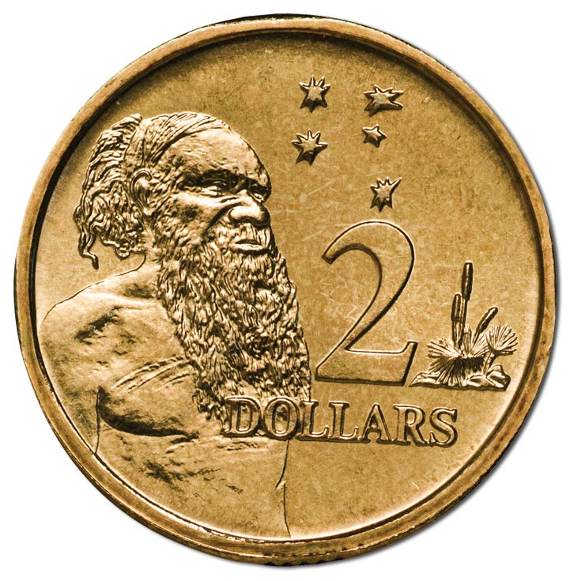
The Mint does not make Australian notes. All our notes are printed in Victoria by a company called Note Printing Australia. If you live in Canberra, or are visiting, you can visit the Mint and see coins being made. You can also make your own coin to take home.

Slide 31
This is the answer from the question: Australian coins that have a bumpy edge are called ‘milled’ coins. Can you work out which one is not are milled coins? (Hint: there is only one coin that is not milled.)

Slide 32
Answer is…

